Slide 1






AI Desktop Assistant
1

Slide 2
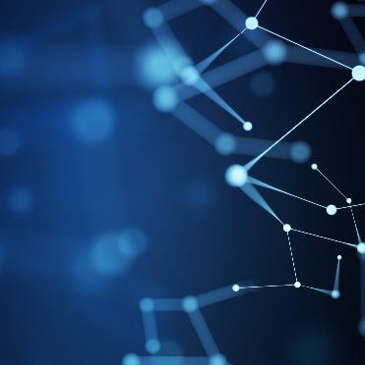
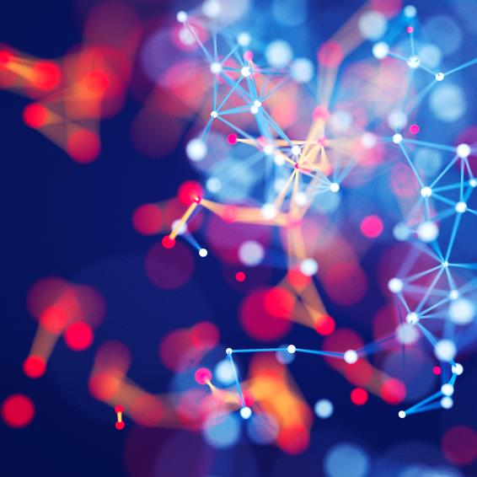

Supervisor
2
Mr. ANKIT VERMA SIR
Team Leader / Member
Aditya Agarwal
210029014008

Slide 3

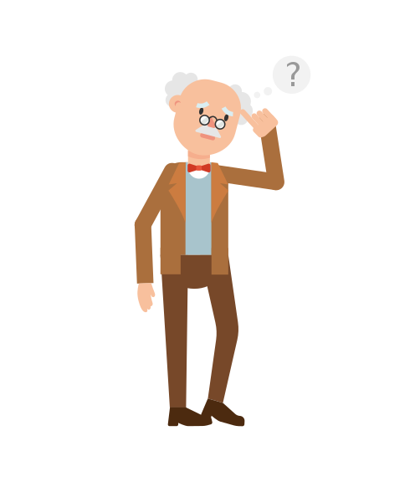
3
Have you ever thought?
How we will be performing tasks on computers when we will get old and how we will be able to do those tasks.

Slide 4
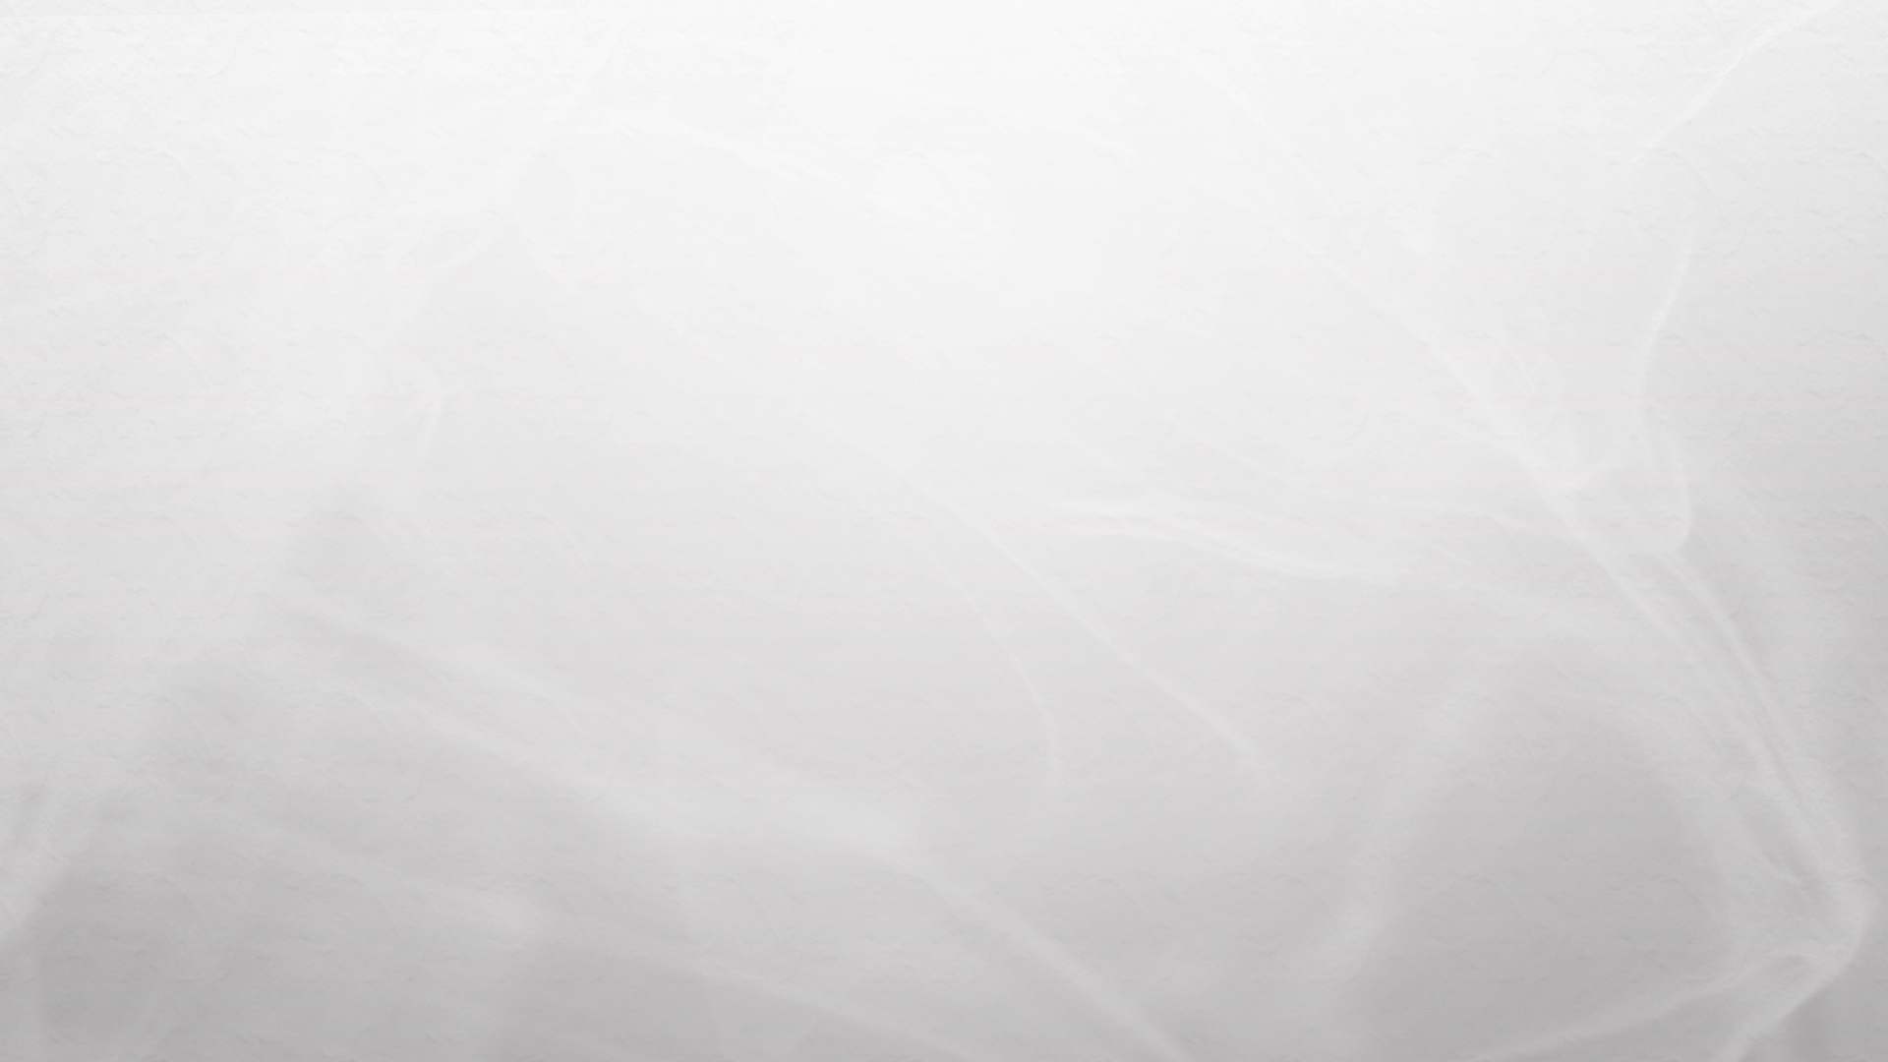
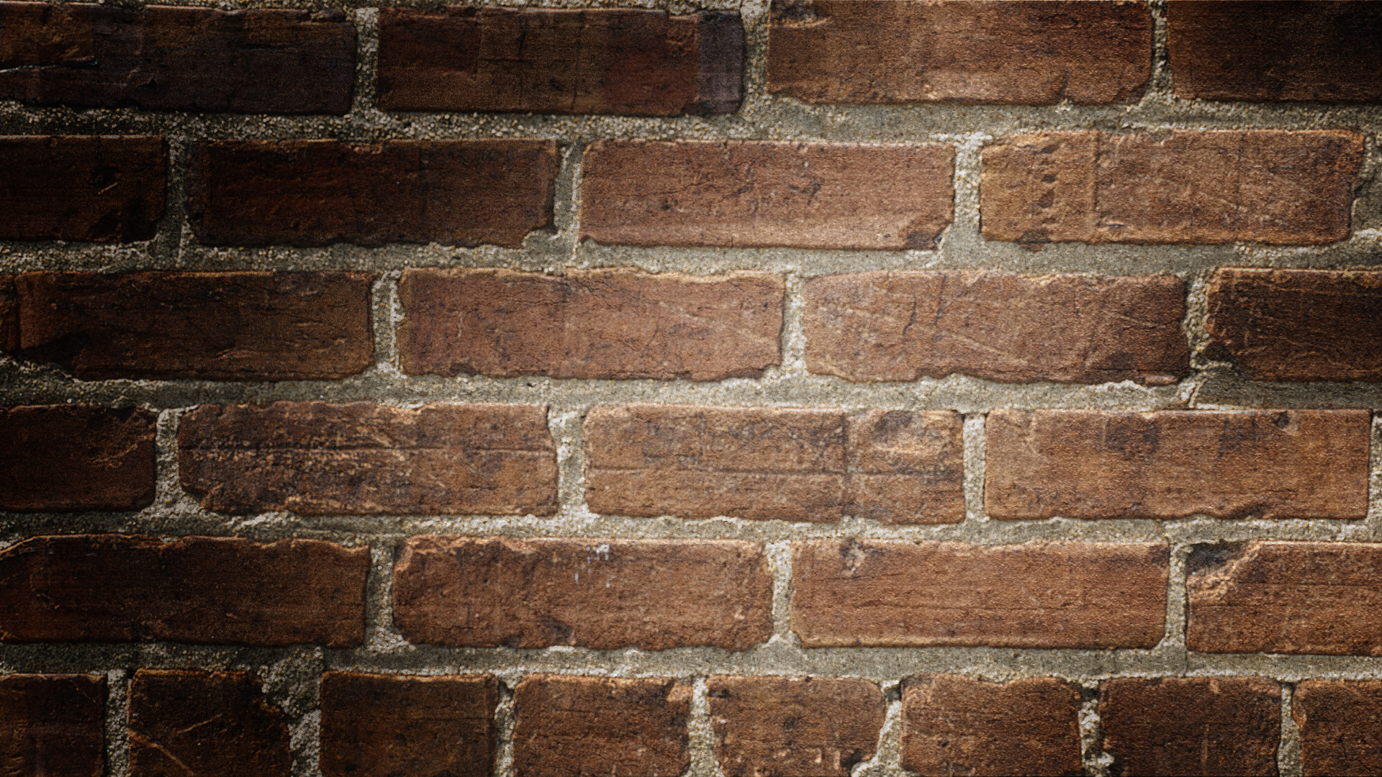

No Worries here is what I have got as the solution.
4

Slide 5

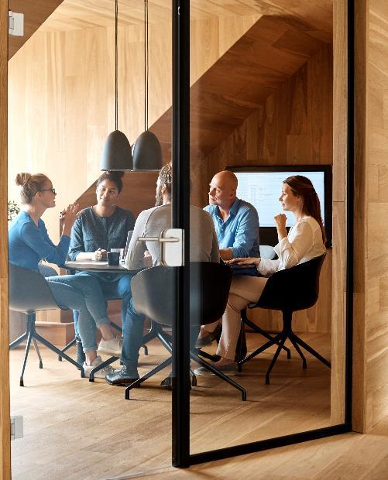
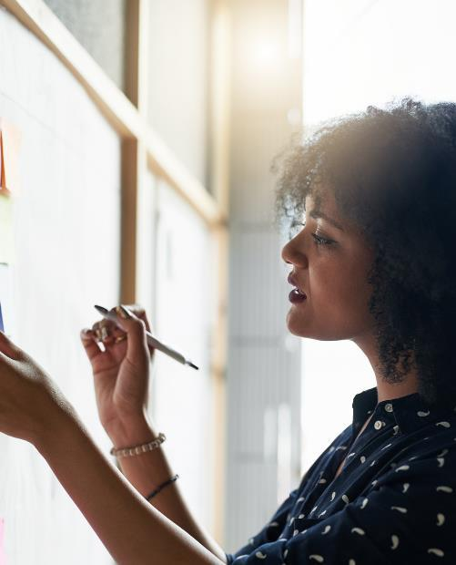



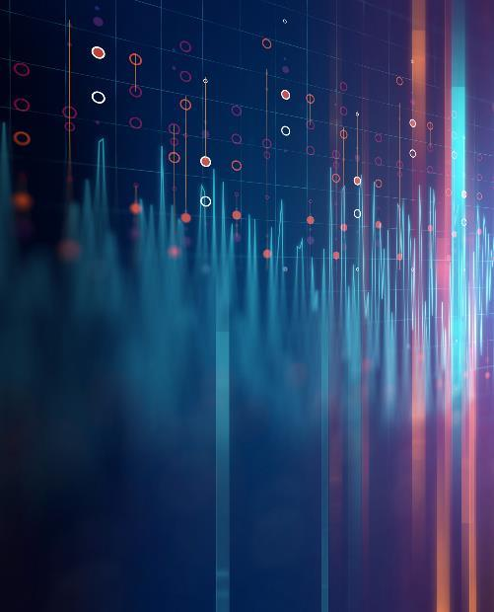

INTRODUCTION
5
Developing an AI Desktop Assistant that will let the user access all the stuff and files on the system by just using his/her voice as a command.
The Assistant will access the files from the path which will be accessed during the time of installation and will function according to the command of the user.

Slide 6
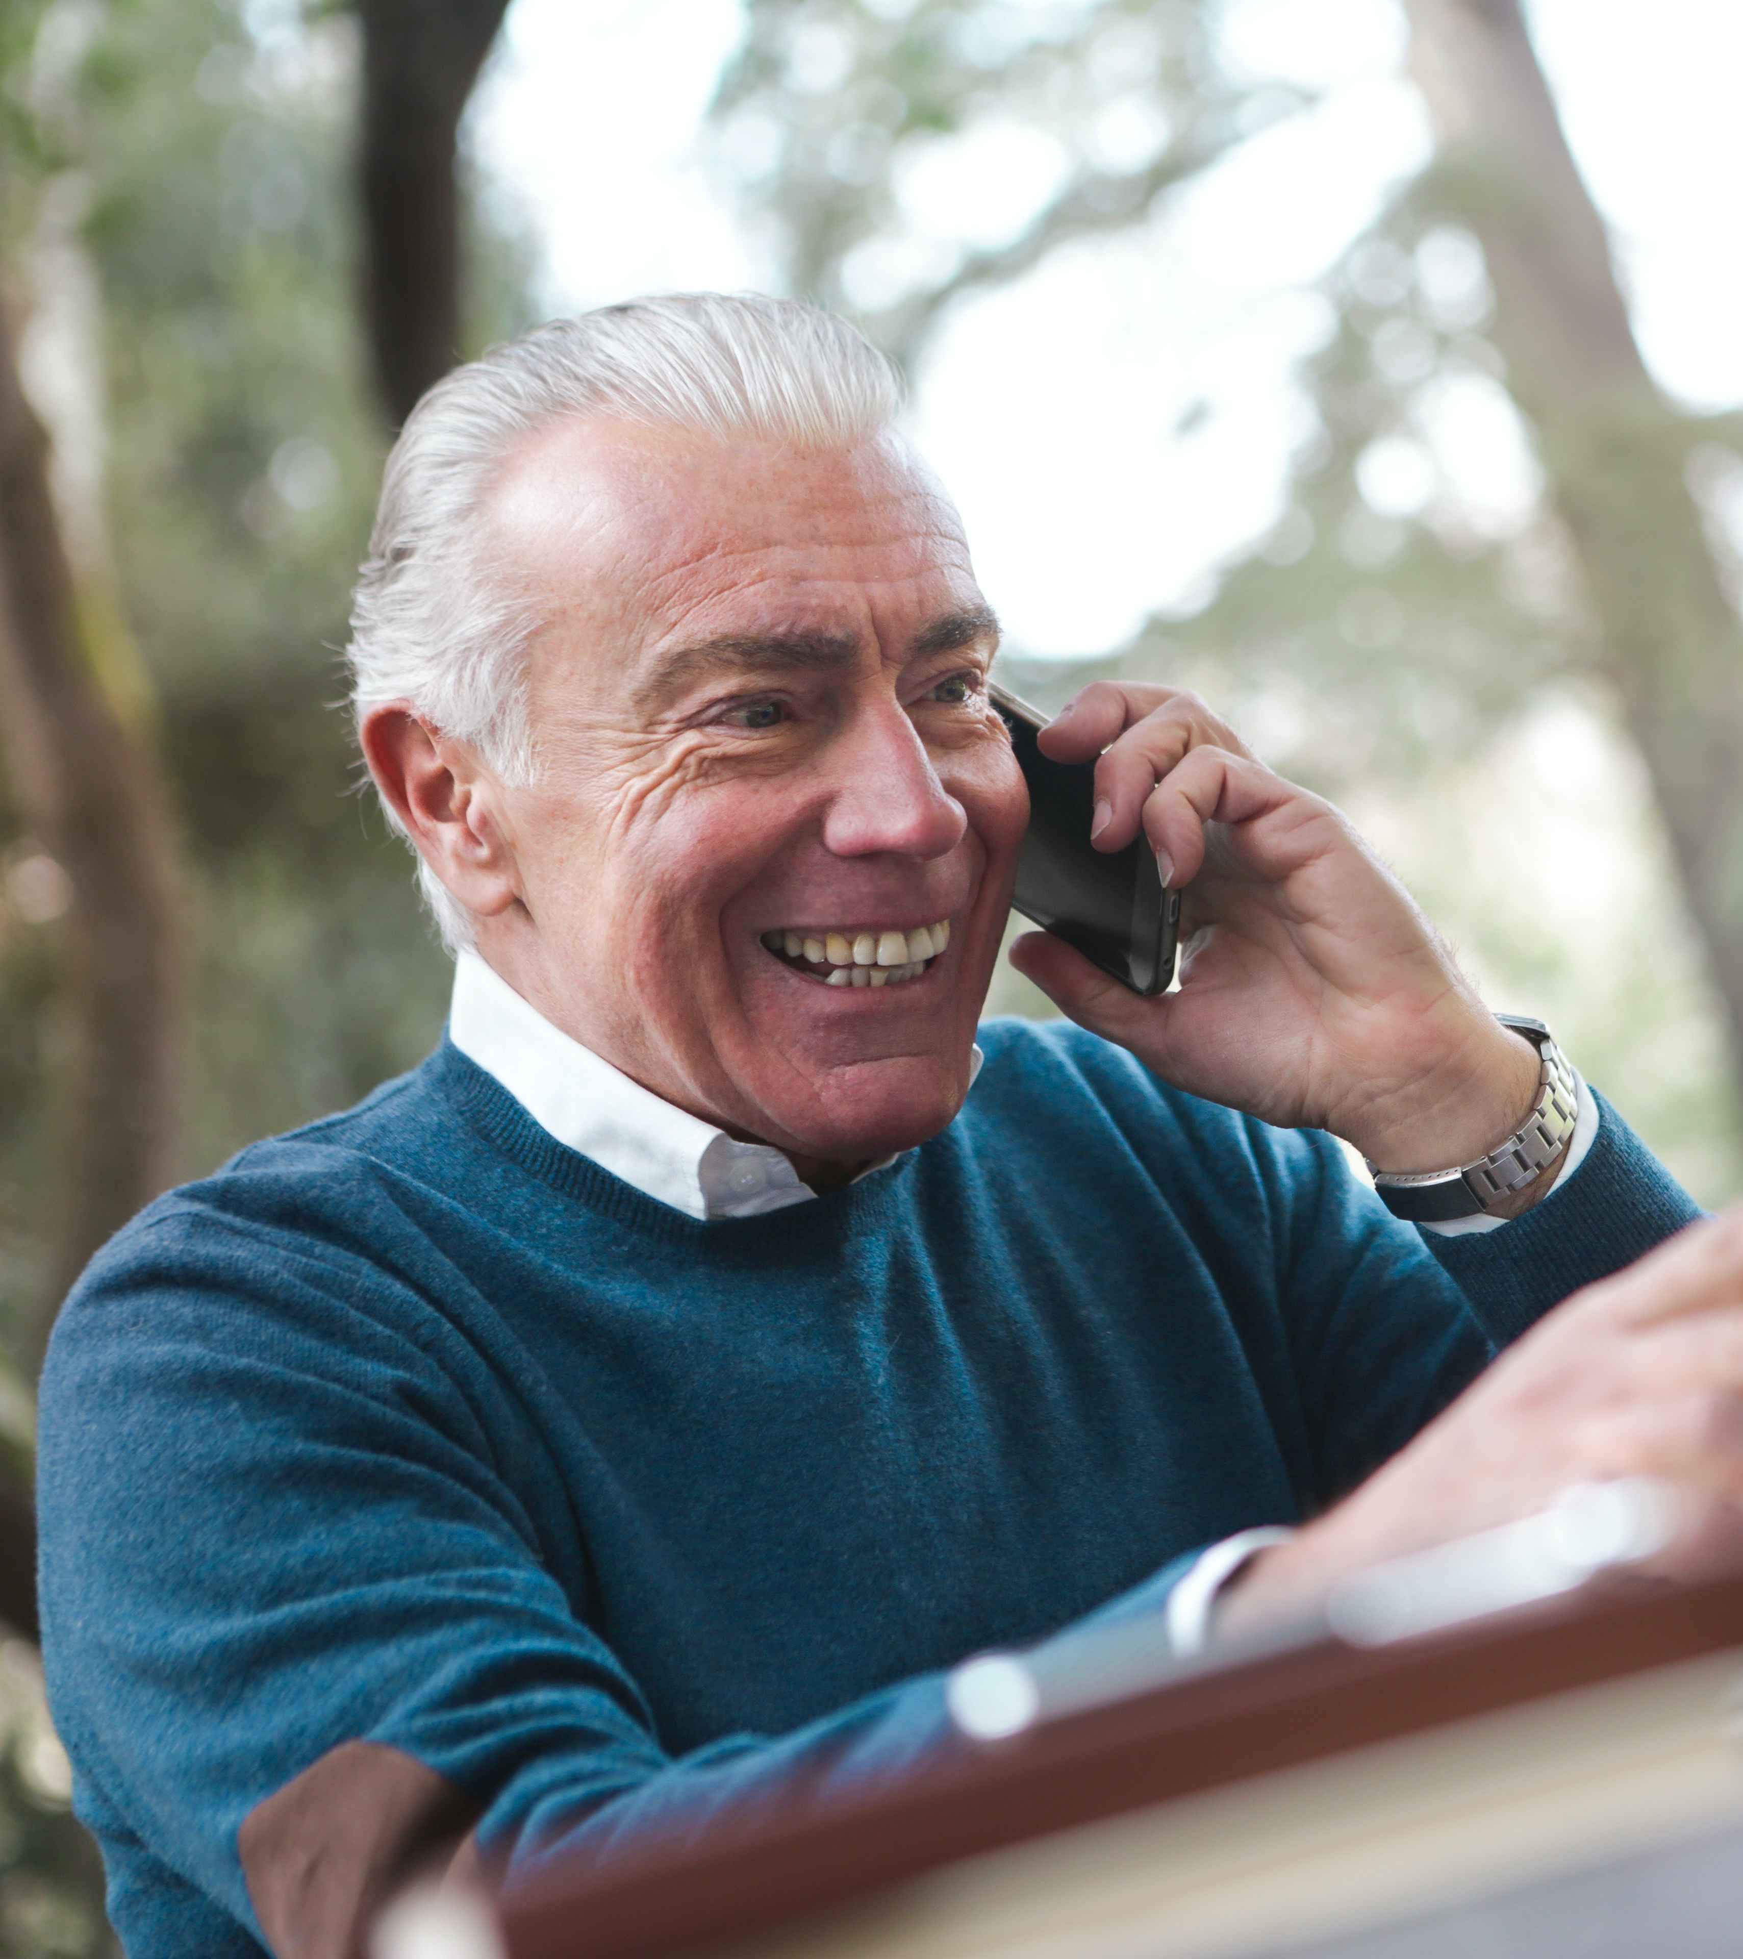
The assistant will let you know the time, temperature, the weekday, and furthermore frequently asked questions. It will let you open your computer application programs like notepad, excel, internet browser, etc., and can also perform some extra functions like Writing text, scheduling remainder, taking screenshots, and many more things.
6

Slide 7

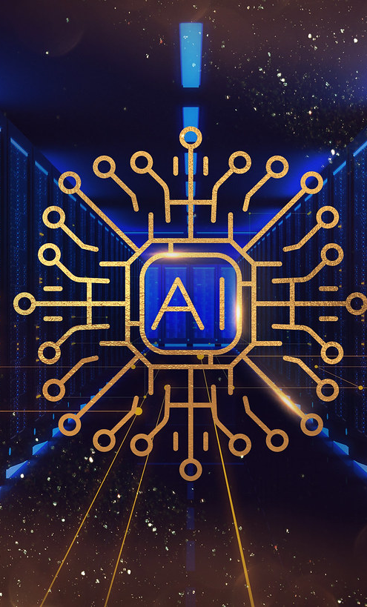




Technology used:-
7
Python
AI

Slide 8

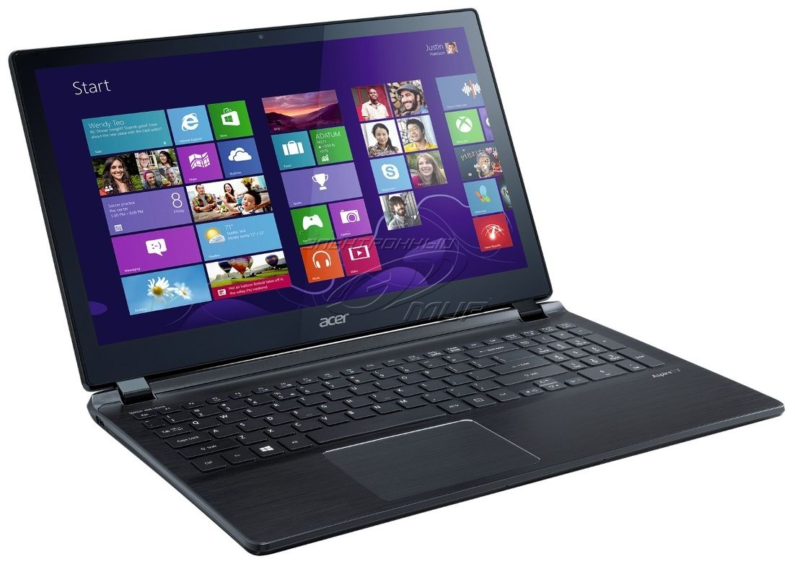
Software used:- PyCharm Hardware and software required:- Processor i5 and above Windows 8 and above 6 GB RAM or above
8

Slide 9
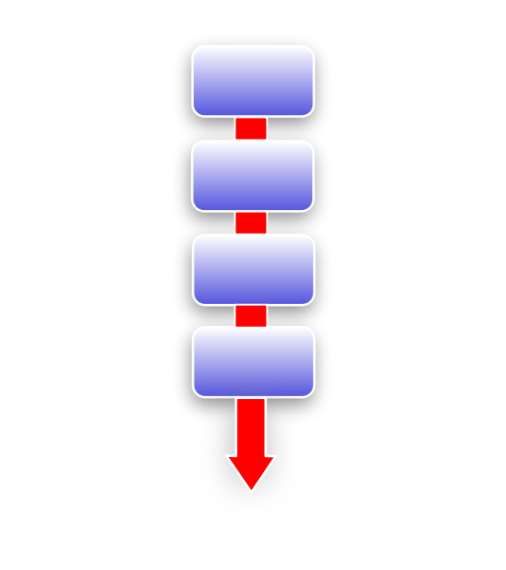
MODULES
9
START
LISTENING
PERFORMING TASKS
EXIT

Slide 10



CONCLUSION:-
10
THIS ASSISTANT WILL DEFINITELY MAKE THE HUMAN LIFE MORE EFFICIENT AND MORE RELIABLE AS IN NOWADAYS MOST OF US WANTS EACH AND EVRY THING TO BE SMART AND IT WILL ALSO BE A BIG GOAL FOR THE RELATIONSHIP BETWEEN THE HUMAN AND COMPUTERS ESPECIALLY FOR OLD AGE AND HANDICAPPED PEOPLE.

Slide 11
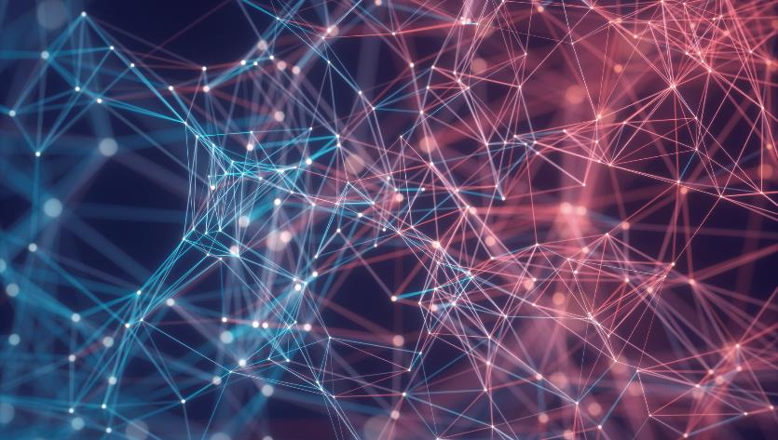

Thank You
11
Presenter name:- Aditya Agarwal
Course & Sec:- MCA(B)
Roll no:- 210029014008

